Slide 1

Bayesian Beats of the US Economy
Project of Bayesian Learning & Montecarlo Simulation
Andrea Ferrarini, Andrea Nardi, Christian Giovanni Pesaturo, Salim Salici
Notes:
This presentation aims to provide a comprehensive analysis of two key macroeconomic time series: the Gross Domestic Product (GDP) and the Consumer Price Index (CPI). I will begin with a preliminary exploratory analysis, then outline the structure of the dataset used, and finally provide a detailed discussion of the theoretical foundations and modeling choices employed within a Bayesian statistical framework.

Slide 2
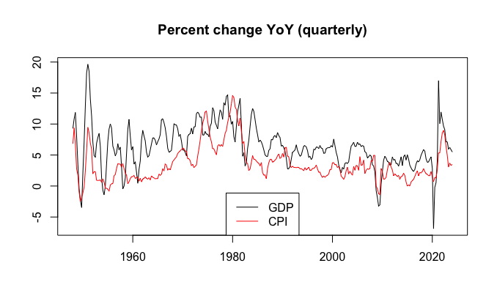
Classes of models
AR
MA
ARMA
a more robust VAR
Notes:
Dataset, the original file “gdp_inflation.csv” underwent careful preprocessing to ensure consistency across both series.
Observations are expressed as seasonally adjusted annual percentage changes.
The dataset was split into two non-overlapping subsets: 85% of the observations were used as a training set for parameter estimation within the Bayesian framework, while the remaining 15% constituted the test set for out-of-sample forecasting and model validation.

Slide 3
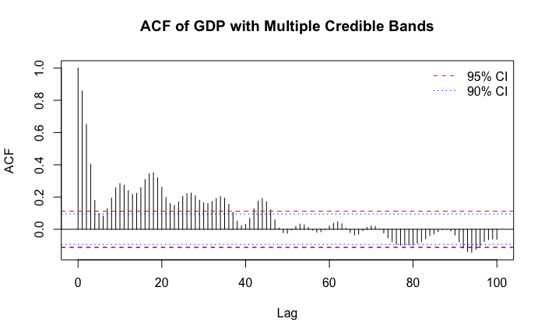
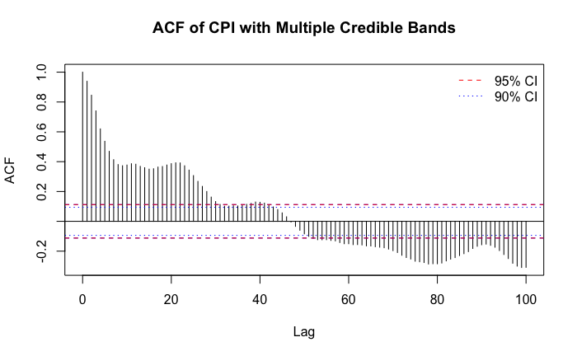
Auto-correlation Function
Notes:
Let us begin by formally defining the Autocorrelation Function (ACF), a fundamental statistical tool for assessing serial dependence in time series data. It quantifies the degree of correlation between observations of the same variable at different time lags, thereby revealing the temporal dynamics underlying the data.
-> In the ACF plot for the GDP series, we observe a that around lag 1 a slow decay with persistently positive autocorrelations. This pattern is indicative of non-stationary behavior and long-memory processes.
This behavior is typical of macroeconomic aggregates like GDP, which often exhibit strong trends and persistent cycles.
-> For the CPI series, the ACF displays a similar shape but with an even more gradual decline. The high autocorrelation at initial lags followed by a slow tapering suggests the presence of long-memory features, possibly more pronounced than in GDP.

Slide 4
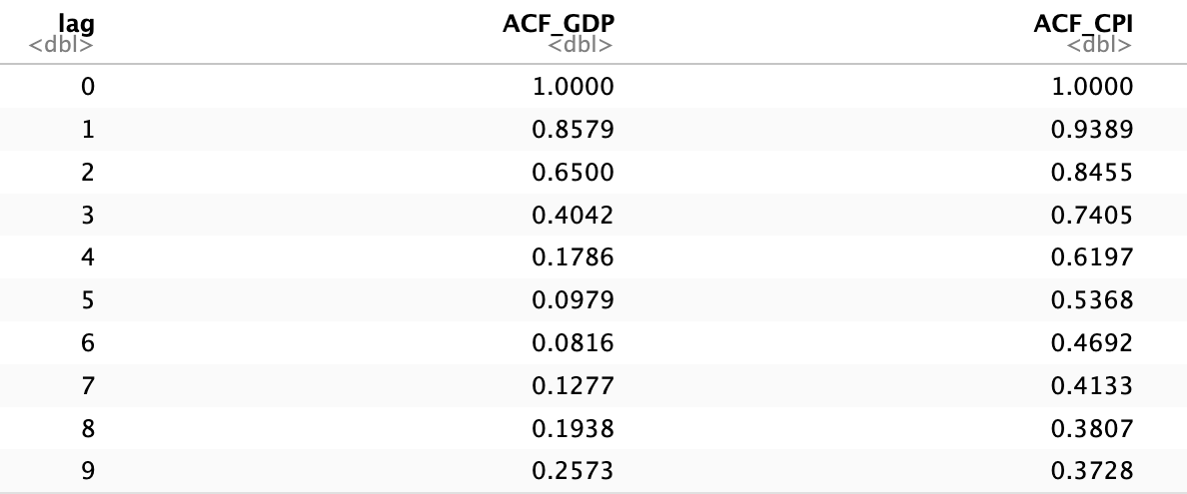
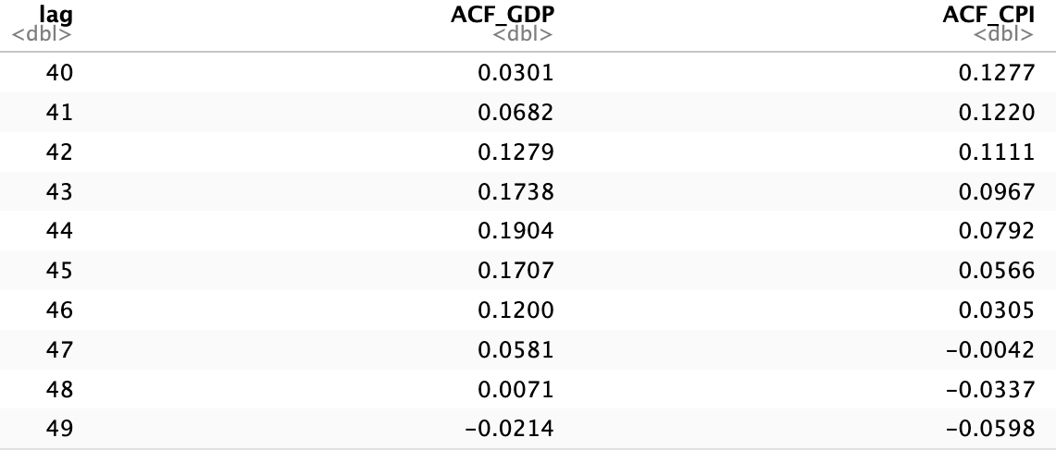
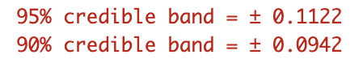
Auto-correlation Function
Notes:
We organized our code into macro‐blocks, each defining one of the models we used. Every model was written in a generic, reusable way so that we didn’t need separate implementations for each order.

Slide 5
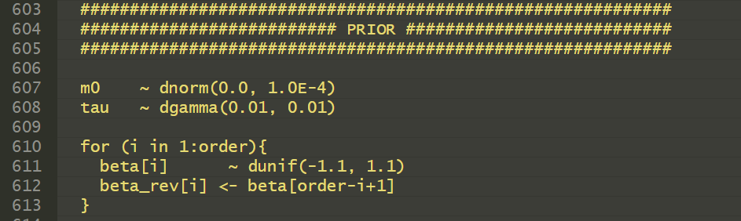
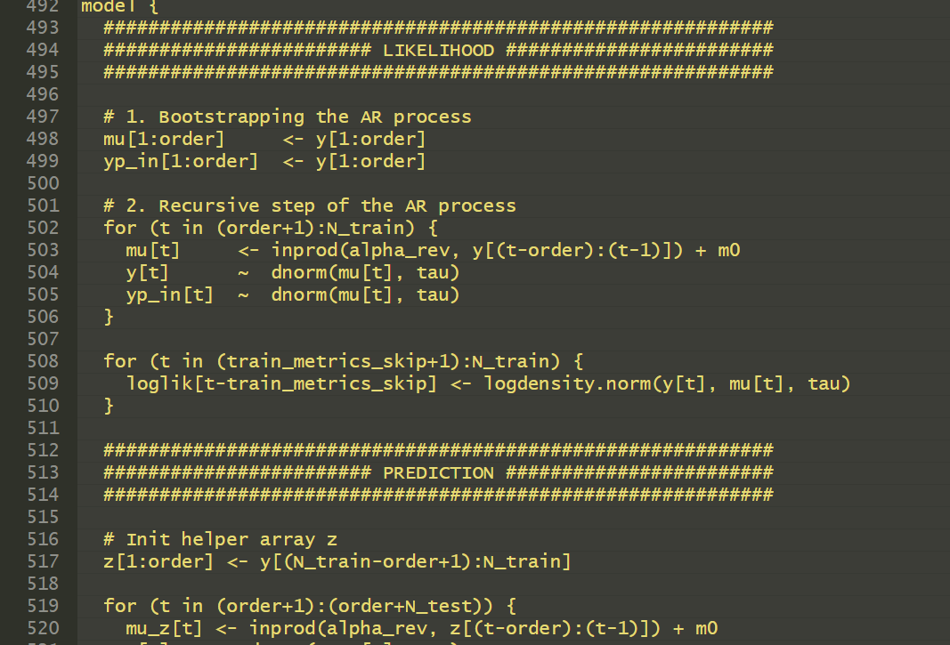
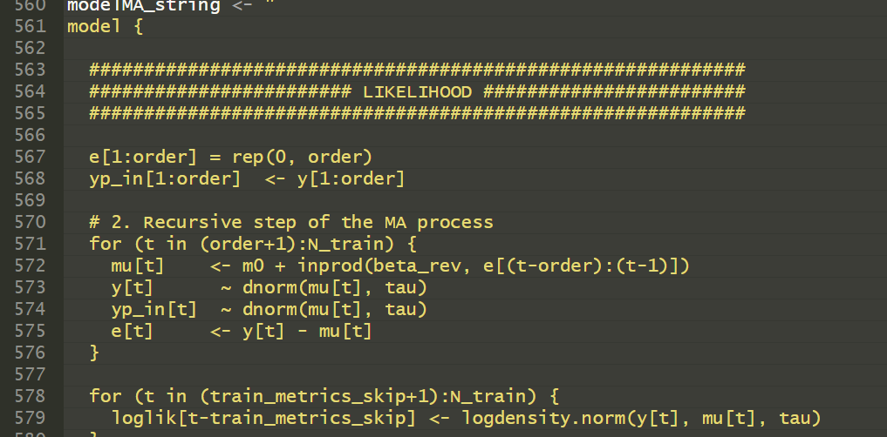
Generic order JAGS scripts
For each model type (AR, MA, ARMA, VAR) we implemented a single JAGS script, enabling flexible evaluation across different orders by simply passing the desired order from R.
This allowed for a more rapid and systematic comparison between models.
Notes:
We organized our code into macro‐blocks, each defining one of the models we used. Every model was written in a generic, reusable way so that we didn’t need separate implementations for each order.

Slide 6
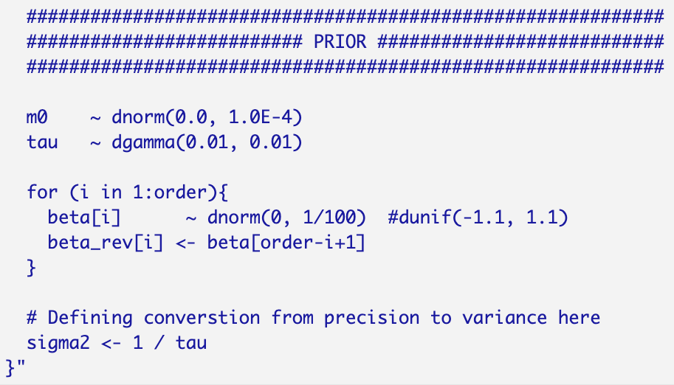
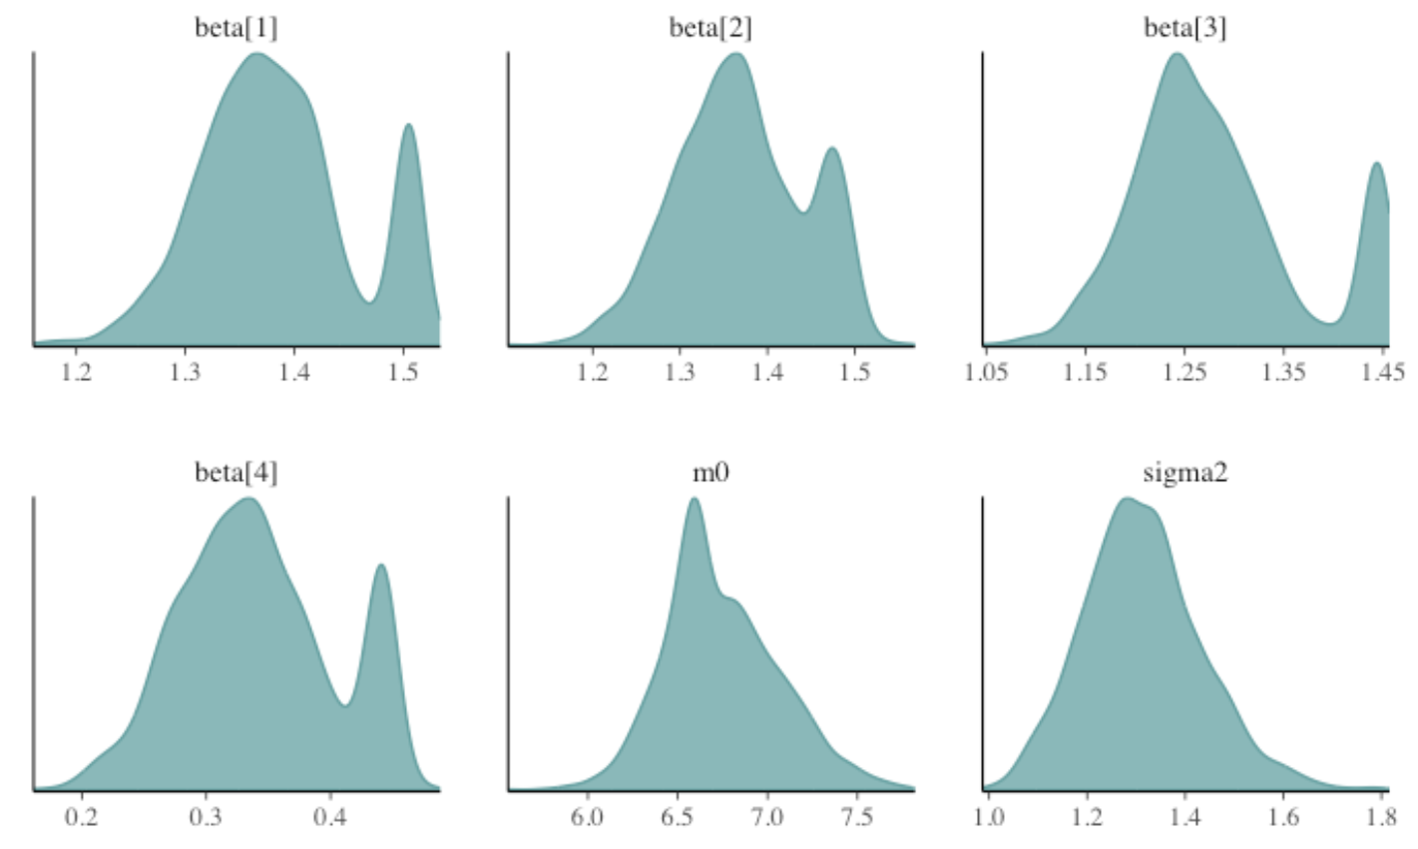
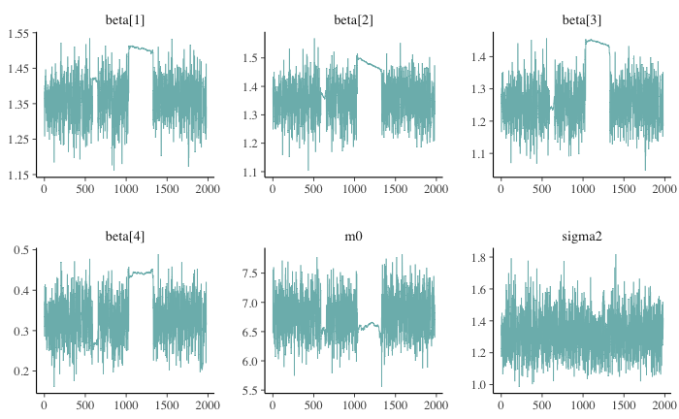
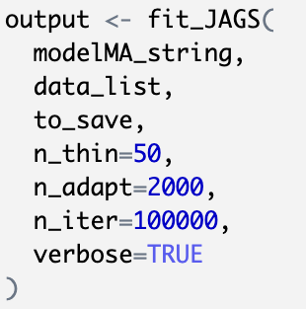
Why this prior choice?
Notes:
Choosing the priors was not easy: after testing many combinations of settings, we discovered that some configurations behaved anomalously, especially in ARMA and MA models.
->For instance, the posterior density for this MA(4) model (with parameters only up to β₄) shows unclear, highly uncertain dynamics.
We can clearly see two distinct “shoulders” in the density of each MA coefficient, underlining a multimodal structure.
Moreover, the posterior densities of σ² and m₀ are strongly asymmetric, indicating substantial uncertainty in their estimation. In general, a narrow density curve implies a precise estimate, while a wide curve signals high uncertainty. If we observe unexpected skewness or multiple peaks, it may be necessary to revisit our priors or reparameterize the model.
->From the trace plot (shown here for a single chain) the sampling path is fragmentary and interrupted, eventually fading out completely after about 1 000 iterations.

Slide 7
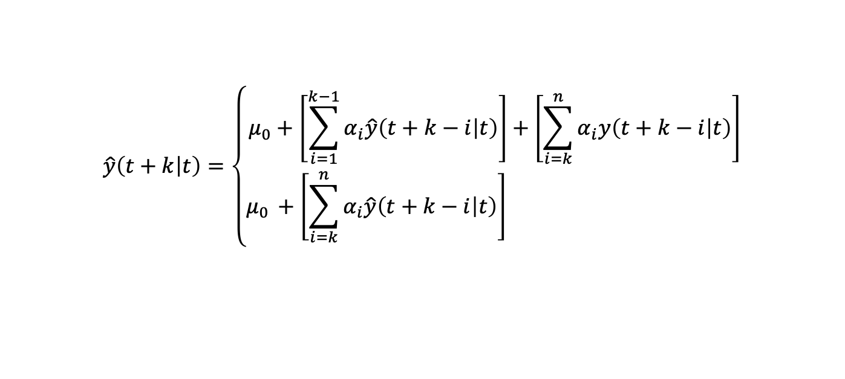
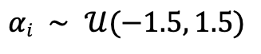
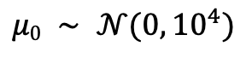

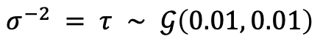
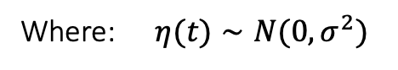
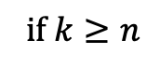
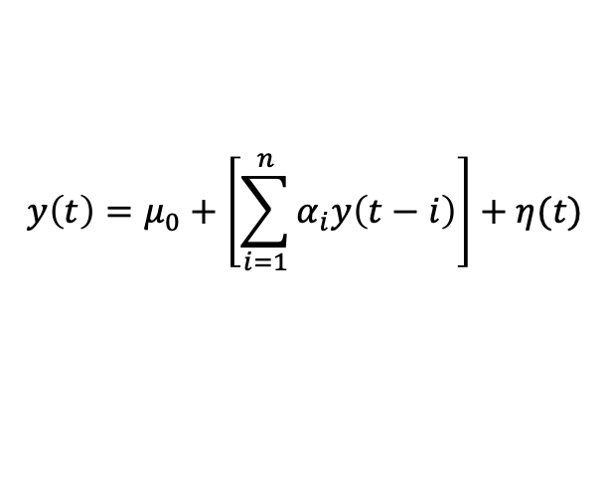
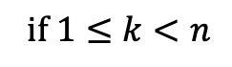
Priors & Likelihood – $AR(n)$
Likelihood:
Priors:
AR coefficients:
$$y\left(t\right)=μ_{0}+\left[\sum_{i=1}^{n}{α_{i}y\left(t−i\right)}\right]+η(t)$$
$$αi ∼ 𝒰(−1.5, 1.5)$$
Process mean & noise variance / precision:
Where: $η(t)∼N(0,σ^{2})$
$$μ0 ∼ 𝒩(0,{10}^{4})$$
$$σ^{−2} = τ ∼ 𝒢\left(0.01, 0.01\right)$$
Predictor:
$$\hat{y}\left(t+k | t\right)=\left\{\begin{aligned}μ_{0}+\left[\sum_{i=1}^{k−1}{α_{i}\hat{y}\left(t+k−i | t\right)}\right]+\left[\sum_{i=k}^{n}{α_{i}y\left(t+k−i | t\right)}\right] \\ μ_{0 }+\left[\sum_{i=k}^{n}{α_{i}\hat{y}\left(t+k−i | t\right)}\right] \end{aligned}\right.$$
$$\text{if} 1≤k<n$$
$$\text{if} k≥n$$

Slide 8
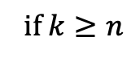

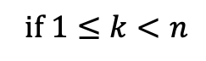
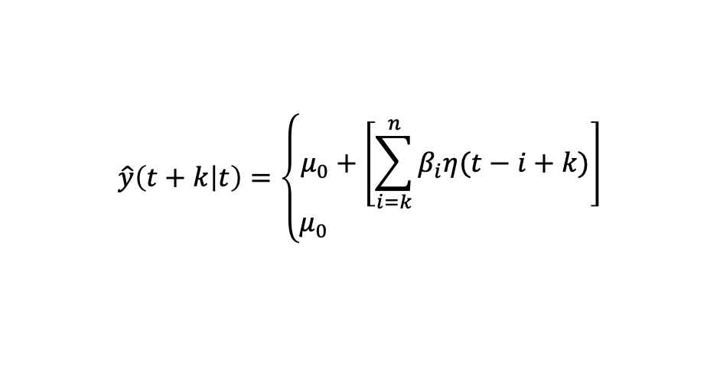
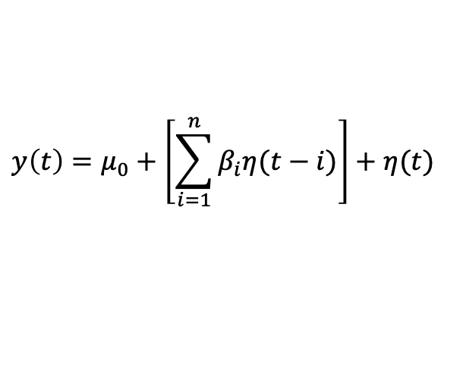
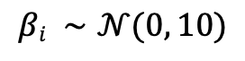
Priors & Likelihood – $MA(n)$
Likelihood:
Priors:
MA coefficients:
$$y\left(t\right)=μ_{0}+\left[\sum_{i=1}^{n}{β_{i}η(t−i)}\right]+η(t)$$
$$βi ∼𝒩(0, 10)$$
Process mean & noise variance / precision:
Where: $η(t)∼N(0,σ^{2})$
$$μ0 ∼ 𝒩(0,{10}^{4})$$
$$σ^{−2} = τ ∼ 𝒢\left(0.01, 0.01\right)$$
Predictor:
$$\hat{y}\left(t+k | t\right)=\left\{\begin{aligned}μ_{0}+\left[\sum_{i=k}^{n}{β_{i}η(t−i+k)}\right] \\ μ_{0} \end{aligned}\right.$$
$$\text{if} 1≤k<n$$
$$\text{if} k≥n$$

Slide 9

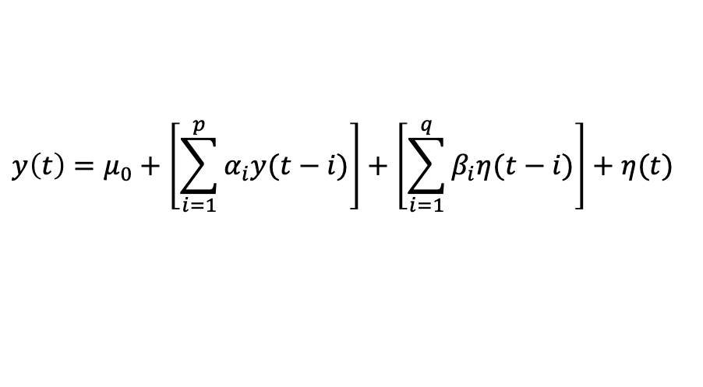
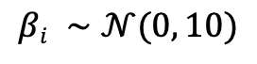
Priors & Likelihood – $ARMA(p, q)$
Likelihood:
Priors:
AR and MA coefficients:
$$y\left(t\right)=μ_{0}+\left[\sum_{i=1}^{p}{α_{i}y(t−i)}\right]+\left[\sum_{i=1}^{q}{β_{i}η(t−i)}\right]+η(t)$$
$$αi ∼ 𝒰(−1.5, 1.5)$$
$$βi ∼𝒩(0, 10)$$
Process mean & noise variance / precision:
Where: $η(t)∼N(0,σ^{2})$
$$μ0 ∼ 𝒩(0,{10}^{4})$$
$$σ^{−2} = τ ∼ 𝒢\left(0.01, 0.01\right)$$
Predictor:
$$\hat{y}\left(t+k | t\right)=AR_{pred}\left(t+k | t\right)+MA_{pred}\left(t+k | t\right)−μ_{0}$$

Slide 10
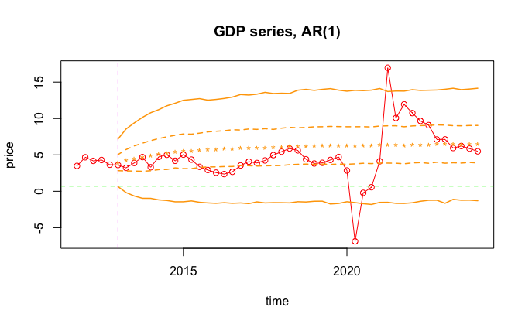
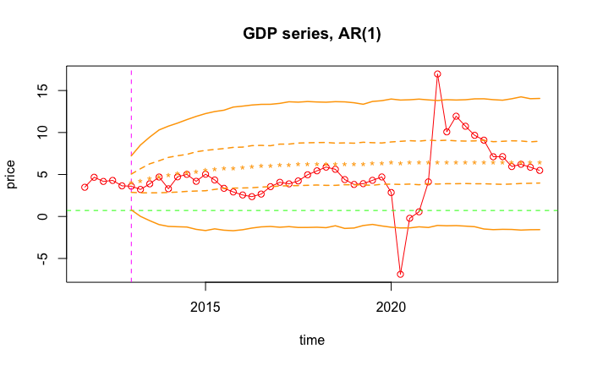


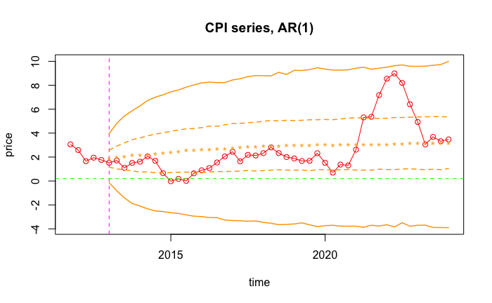
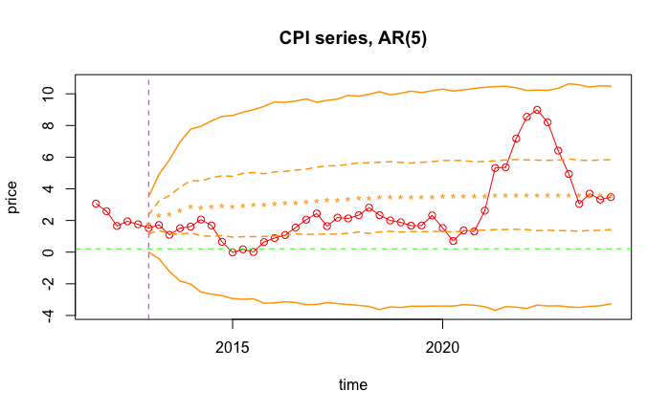
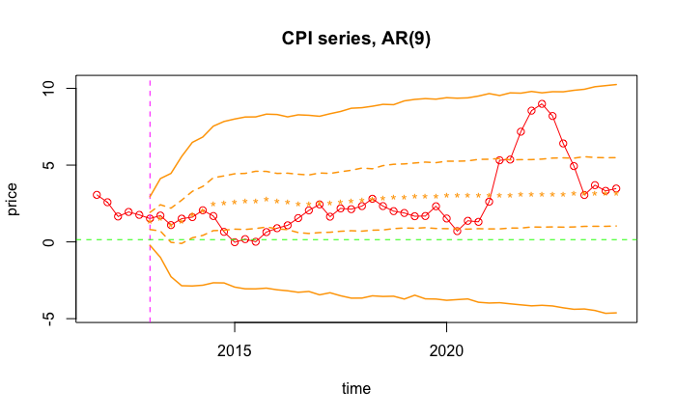

$AR(n)$ out-of-sample forecasts
...
...
...
...

Slide 11
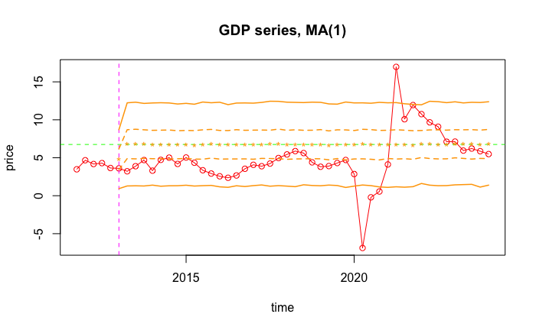
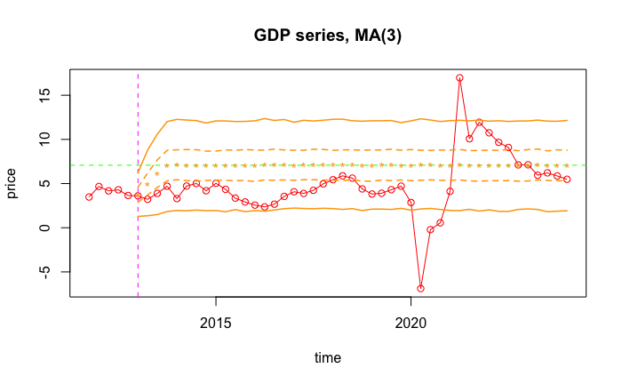
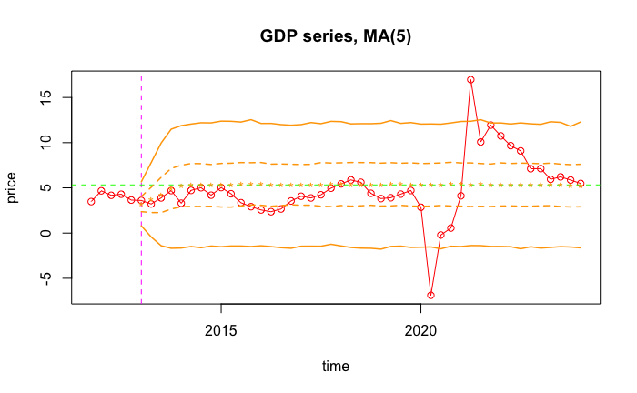
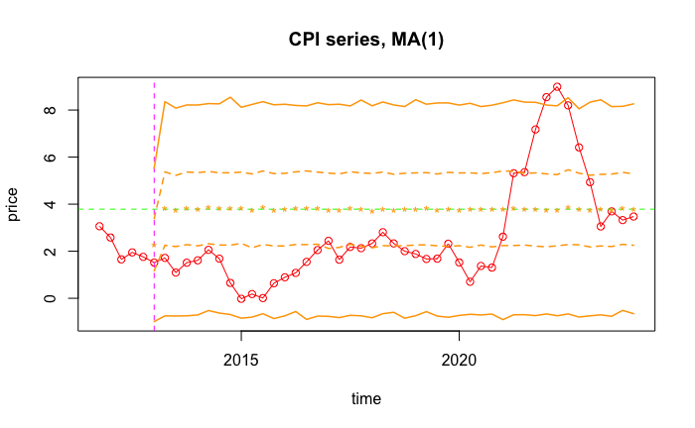
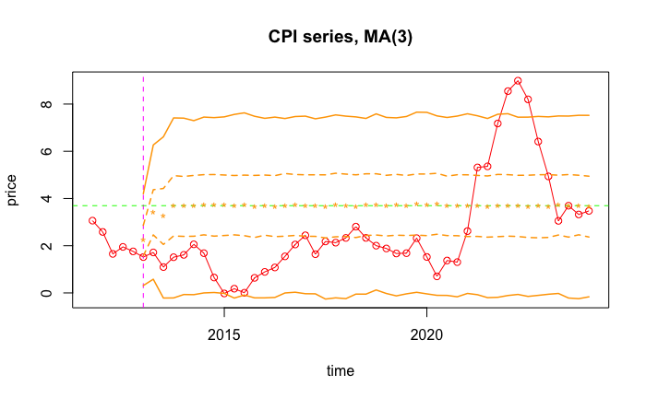
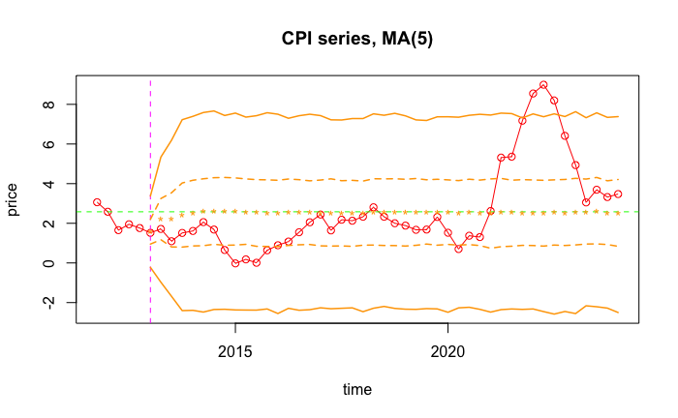

$MA(n)$ out-of-sample forecasts
...
...
...
...

Slide 12

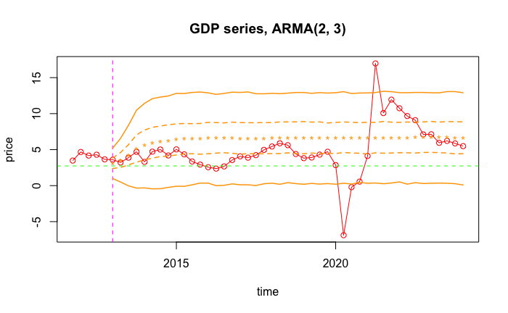
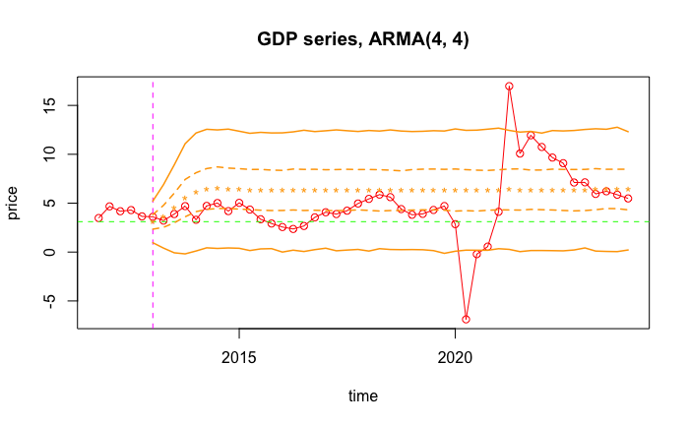
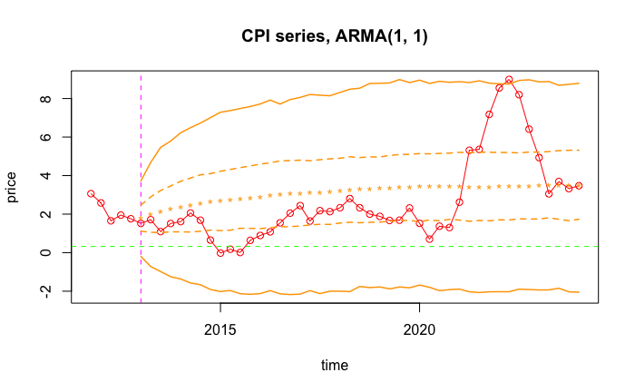
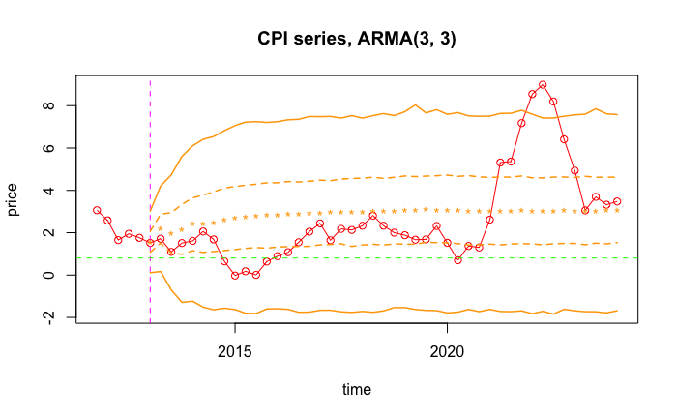
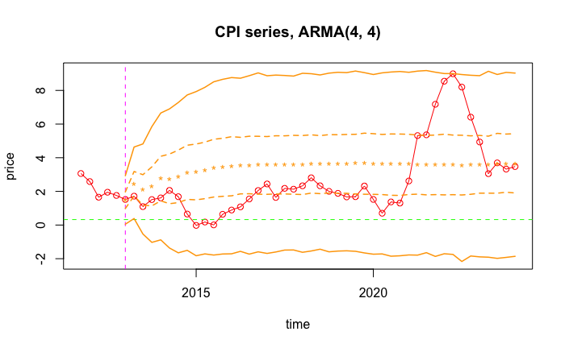
$ARMA(p, q)$ out-of-sample forecasts
...
...
...
...

Slide 13
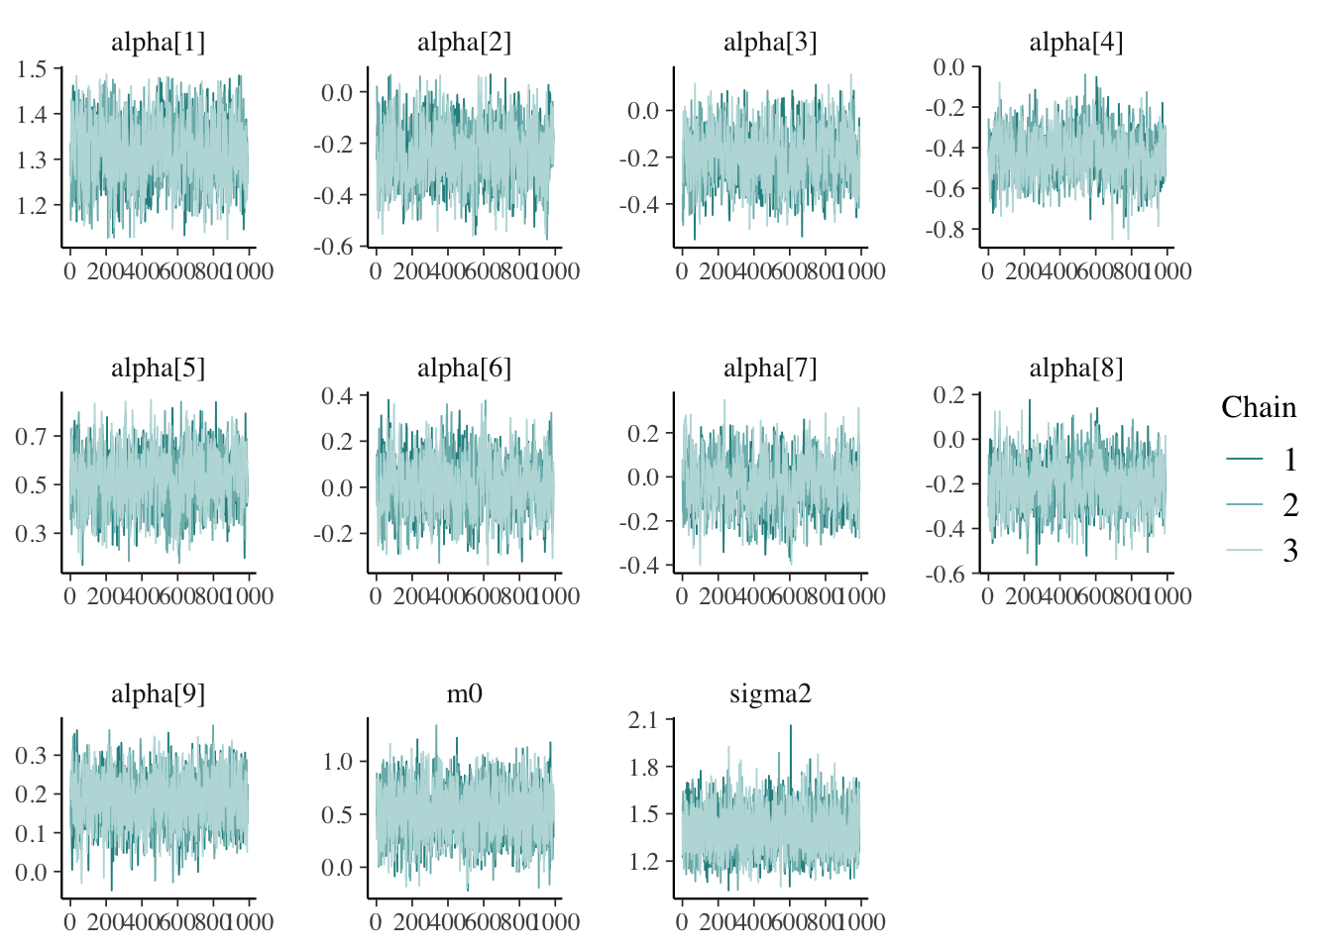
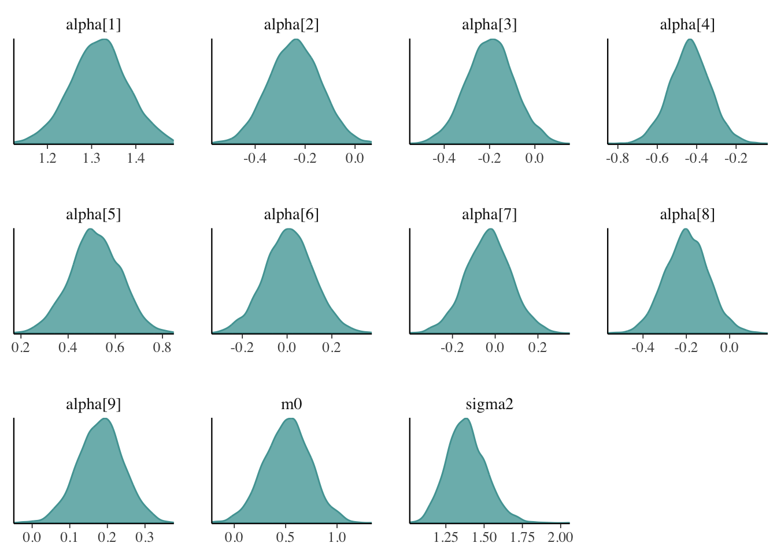
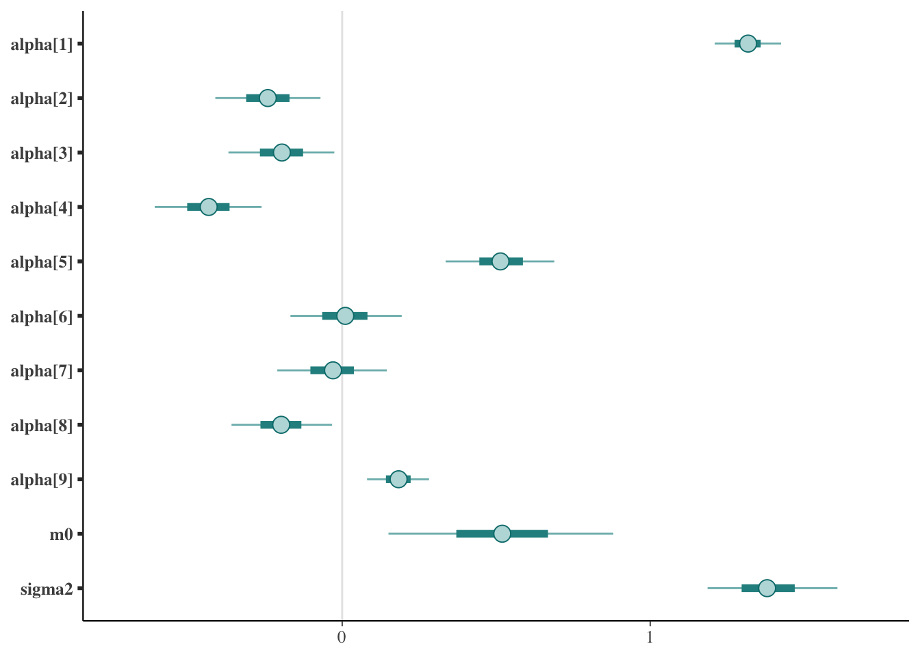
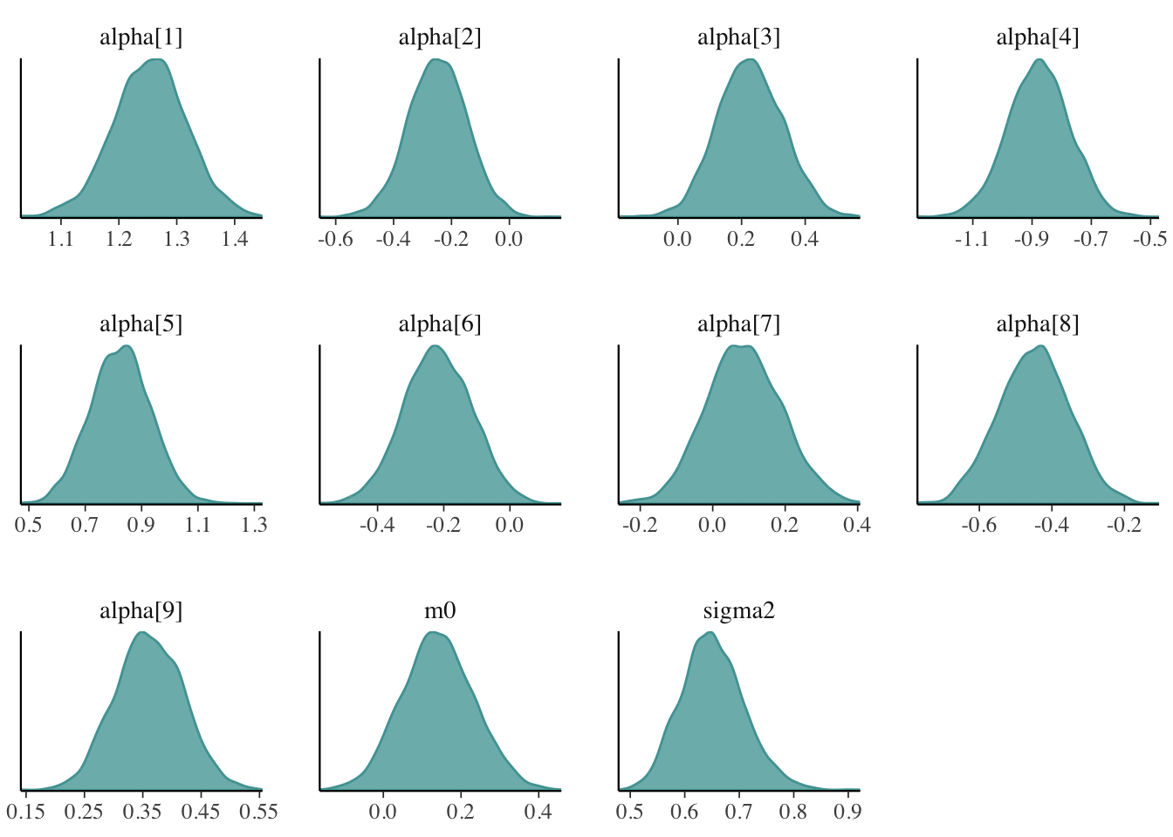
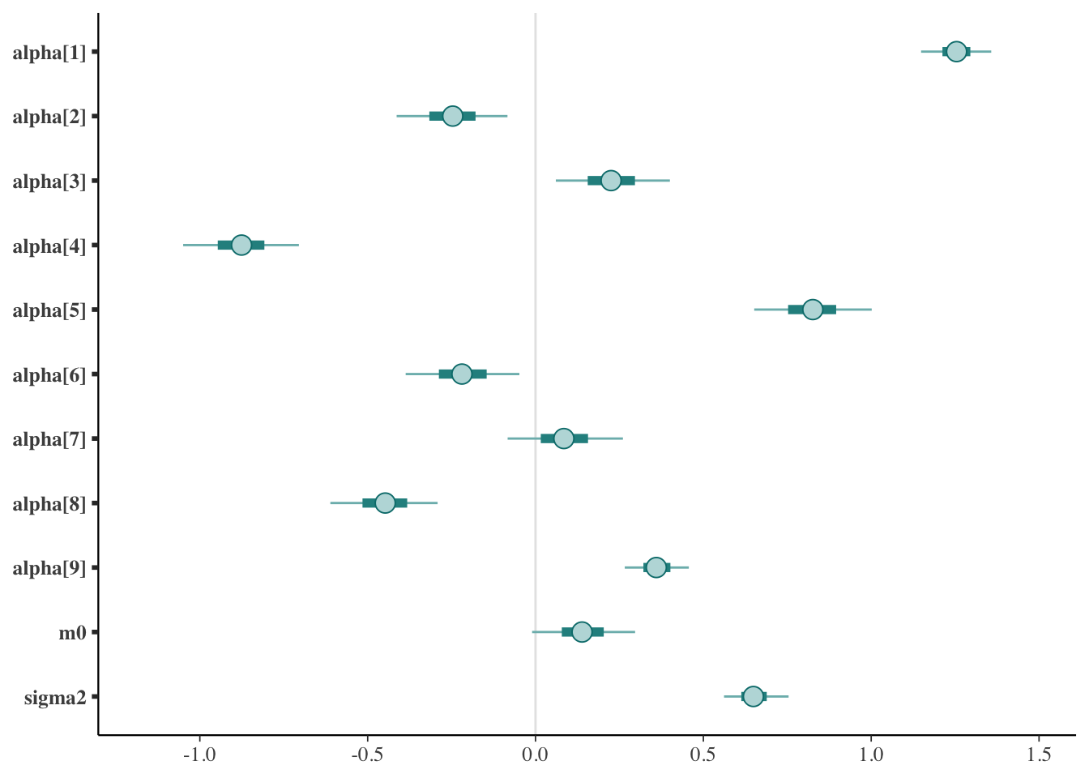
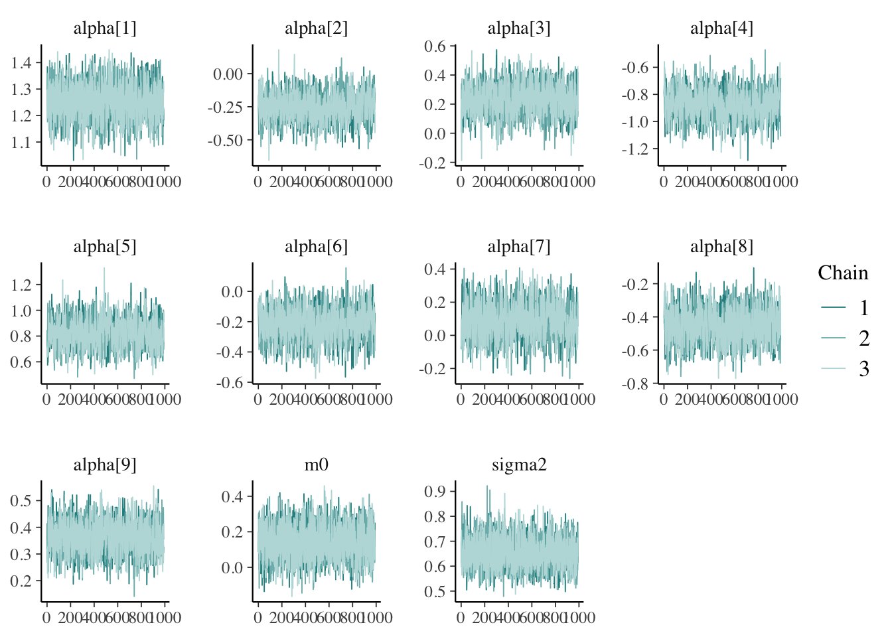
Trace and density plots (Auto-Regressive Model)
GDP – AR(9)
CPI – AR(9)

Slide 14






Trace and density plots (Moving Average Model)
GDP – MA(3)
CPI – MA(4)

Slide 15






Trace and density plots (ARMA Model)
GDP – ARMA(2,3)
CPI – ARMA(3,3)

Slide 16


Metrics for assessing fitted models - GDP

Slide 17


Metrics for assessing fitted models - CPI

Slide 18


HeatMap
Gross Domestic Product
Consumer Price Index

Slide 19







Priors & Likelihood – $VAR(n)$
Priors:
Likelihood:
A matrix:
$$\overset{⃑}{y_{t}}=\sum_{o=1}^{n}{A_{o}\overset{⃑}{ y_{t−o}}}\text{+}\overset{⃑}{ m_{0}}+\overset{⃑}{ ε_{t}}\text{,}$$
$$(Ao)ij ∼ U(−1.2, 1.2)$$
where
$$\overset{⃑}{ ε_{t}} \sim 𝒩(\overset{⃑}{ 0}, Σ)$$
Intercept:
$$m0i∼ N (0, {10}^{4})$$
Predictor:
Noise variance / Precision:
$τ \sim Wishart\left(I, 3\right)$ , $Σ$ = $τ^{−1}$
$$\hat{y}\left(t+k | t\right)=\left\{\begin{aligned}m_{0}+\left[\sum_{i=1}^{k−1}{A_{i}\hat{y}\left(t+k−i | t\right)}\right]+\left[\sum_{i=k}^{n}{A_{i}y\left(t+k−i | t\right)}\right], if 1≤k<n \\ m_{0 }+\left[\sum_{i=k}^{n}{A_{i}y\left(t+k−i | t\right)}\right], if k≥n\end{aligned}\right.$$

Slide 20




Vector Auto Regression – VAR(n)

Slide 21



Trace and density plots (VAR Model)
VAR(1)

Slide 22





Vector Auto Regression – Analisys with different priors (1)
We tested 2 different priors for the precision matrix$τ$
Diagonal prior:
$$τ= \left(\begin{matrix}τ_{11} & 0 \\ 0 & τ_{22}\end{matrix}\right)$$
$$τ_{11},τ_{22}∼ Gamma(0.01, 0.01)$$
Wishart prior:
$τ \sim Wishart\left(I, 3\right)$ , $Σ$ = $τ^{−1}$

Slide 23






Vector Auto Regression – Analisys with different priors (2)
Posterior mean of A with diagonal prior
Posterior means of 𝜮 with diagonal prior
A_{d} = $\left(\begin{matrix}0.9085 & −0.0350 \\ 0.0801 & 0.8854\end{matrix}\right)$
$Σ$_{d} = $\left(\begin{matrix}2.6061 & 0 \\ 0 & 0.9611\end{matrix}\right)$
Posterior mean of A with Wishart prior
Posterior means of 𝜮 with Wishart prior
A_{w} = $\left(\begin{matrix}0.9083 & −0.0364 \\ 0.0795 & 0.8854\end{matrix}\right)$
$Σ$_{w} = $\left(\begin{matrix}2.5932 & 0.5525 \\ 0.5525 & 0.9571\end{matrix}\right)$
A Wishart prior doesn’t affect noticeably the fitted A matrix
Pearson correlation coefficient:
A_{d} - A_{w} = $\left(\begin{matrix}0.0002 & 0.0014 \\ 0.0006 & 0.0000 \end{matrix}\right)$
ρ($ε_{GDP}$, $ε_{CPI}$) ≈ 0.3507

Slide 24
Anomaly detection: setup
To start, we need to ensure that $y_{GDP}(t)$ and $y_{CPI}(t)$ follow (or can be approximated to) a RW.
In our case, fitting an $AR(1)$ process to both yields respectively values of $0.86$ and $0.94$for $α$.
We now consider the following series both for GDP and CPI: $Δ\left(t\right)= y\left(t\right) – y\left(t−1\right)$.
We will assume that: $Δ\left(t\right) \sim 𝒩\left(μ,σ_{t}^{2}\right)$, all of which $i.i.d$ one with respect to the other.
Finally, we model our variances as: $σ_{t}^{−2}=τ_{t}= β_{0}+β_{1}δ_{t}$ where: $δ_{t} \sim \text{Ber}(p)$.
As a result, we can find timestamps associated with anomalies / unexpected events by inspecting the $δ_{t}$ series: small values of $𝔼\left[δ_{t}\right]$ will yeild smaller values of $τ_{t}$, hence a greater variance, and viceversa.
Priors used: $β_{0},β_{1} \sim ℇ(0.01)$ $μ \sim 𝒩(0, 100)$ $p \sim \text{Beta}(1, 1)$

Slide 25




Anomaly detection: results

Slide 26


Beyond the hedge: Test on the Residuals
Notes:
Something important before we starting, so this part is not inside the code or the final relation.
Our "Beyond the hedge" analysis start to the fact that the metrics are only a partial indicator of the goofness of the models, it doesn't emphasize the dynamic characteristics of the system. Me must also verify the Whitness of the residuals, ensuring that no predictable patters remain.
We can test even whether there is a correlation betwen the residual.

Slide 27



Conclusions & remarks: Whiteness of the Residuals

Slide 28


Conclusions & remarks: Whiteness of the Residuals
Notes:
Finally, to check that forecast errors follow a Gaussian distribution with zero mean, we can plot a normalized histogram (area = 1) of the errors and overlay a normal density curve with mean 0, and variance equal to square error of the residuals.
->This work shows that beyond correlation curves and performance metrics, curiosity is the true engine of analysis—and only through curiosity can we turn numbers into knowledge.

Slide 29
Beyond every plot and performance score lies one constant: curiosity. It’s the spark that turns statistics into story.

